Slide 1
Introduction to Genetics and Lyme Disease
Oslo, Norway
April 24,2017
Robert Miller, CTN
Certified Traditional Naturopath
Founder & President
NutriGenetic Research Institute

Slide 2
Created by Robert Miller, CTN, a traditional naturopath, to…
study the relationship between genetics SNPs and health conditions
provide education to health professionals
First research project on SNPs and Lyme disease received research award from ILADS International (Helsinki, June 2016)
Presented Lyme disease Phase II research at ILADS Philadelphia, PA conference (November 2016)
Preparing Lyme disease Phase III research for ILADS International
(Paris, May 2017)
Members of the NutriGenetic Research Institute advisory board include MDs, PhDs, acupuncturists, nutritionists and chiropractors
Visit www.nutrigeneticresearch.org for videos on research and updates on future studies

Slide 3
So, How Did I Get Interested in Lyme and Genetics?
I started seeing people with Lyme and they referred to others.
I noticed similar patterns in those with chronic Lyme.
We created a study to see if there was a pattern, and found it to be consistent.

Slide 4
Basic Premise of This Presentation
Some people get bit by a tick and they are fine, others respond quickly to anti-biotics and others suffer for years…..I am proposing that those who struggle the most:
Have a genetic pattern that may create excess free radicals.
Have a genetic pattern that makes less antioxidants, thus creating difficulty with detox.
These individuals may also have had exposure to environmental toxins, thus putting a further burden on the body.

Slide 5
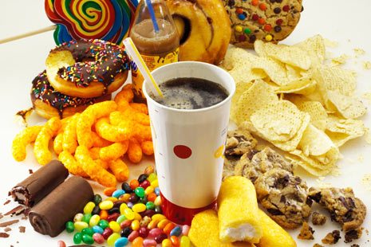
Basic Premise of MethylGenetic Nutrition
Poor diet, environmental toxins, and genetic variants in our DNA cause an…
Increase in toxic substances.
Decrease in critical nutrients and molecules needed for good health.

Slide 6
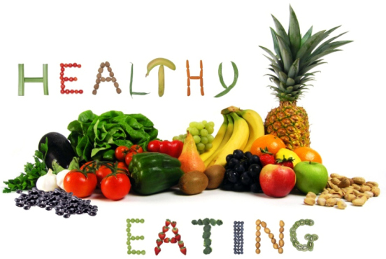
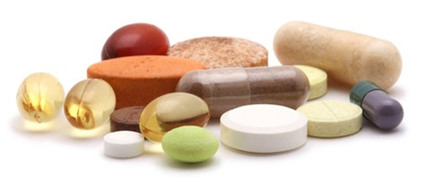
Basic Premise of MethylGenetic Nutrition
By supplying good nutrition and targeted supplementation to compensate for genetic variants, we can…
Decrease oxidative stress,
Increase antioxidants,
Support detoxification, and
Support the healthy rebuilding of the cells and organs.

Slide 7
Basic Premise of MethylGenetic Nutrition
No longer the old model of “treating” or “take this for that”
This is a new paradigm based on the scientific principles of biochemistry
Rather than suppress a symptom, MethylGenetic NutritionTM is focused on finding either a “nutrient deficiency” or an excess of a molecule that is toxic or harmful to the body
As nutrient deficiencies are compensated for (with supplementation) or the removal of toxins is supported, the body comes into balance

Slide 8
Enzymes Make it Happen!
Enzymes, along with co-factors, take substance A and turn it into B
Substance B may be a critical nutrient we need, or a safer substance from a toxic substance
Genetic variants (SNPs) may cause less than optimal conversion of substance A to B
And since co-factors are needed, a lack of co-factors will impede the substance A to B conversion
A
Enzymes & Co-Factors
B

Slide 9
Enzymes Make it Happen!
A person with a heterozygous or homozygous SNP may have a decreased ability to convert (substrate A) to (product B)
A
B

Slide 10
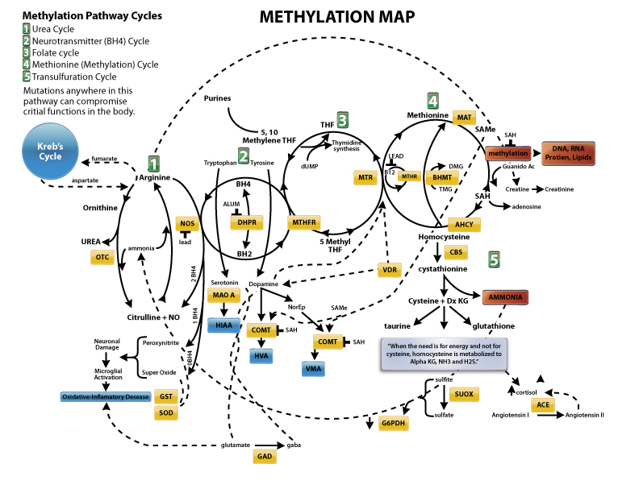
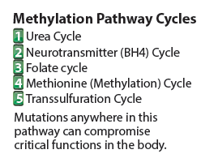

Slide 11
Summary
Thousands of reactions occur per second to make our mind and body work
DNA are the instructions on how to make the enzymes that turn A into B
SNPs in the DNA (inherited) or lack of cofactors can impede the reactions, resulting in dysfunction
Finding the SNPs, and understanding gene function, can allow you to create a plan to compensate for the inherited deficiencies

Slide 12
DNA 101
Your DNA controls virtually everything about you (your height, eye color, etc.).
However, your DNA also controls how you can make nutrients that are critical for healthy functioning.
Your DNA controls how your body clears toxic substances.
Your DNA controls how effectively you can make the critical antioxidants needed to neutralize damaging free radicals.
Nutritional DNA testing is related to using your DNA information to determine how you can supplement and compensate for nutritional deficiencies that are a result of your inherited DNA.

Slide 13
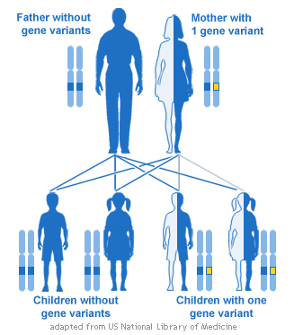
Parents & Genes to Children
Each parent passes on one of their two sets of genes to their children

Slide 14
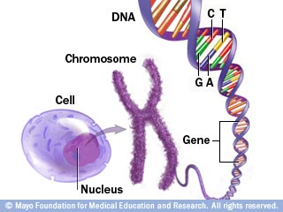
DNA, Genes & Chromosomes
DNA, genes, and chromosomes are like a blueprint of life.
They are the plans that tell the body how to make things.
Long molecules of DNA, containing our genes, are organized into pieces called chromosomes.
Chromosomes are found in the nucleus of every cell.

Slide 15
DNA – Making Enzymes
A double-stranded molecule composed of sugar, phosphate, and 4 different nitrogenous bases – adenine, thymine, cytosine, and guanine.
These bases spell out the language known as genetic code.
The number and the order of these bases determine what makes you unique.
Adenine and thymine bond together as a base-pair, and cytosine and guanine bond to make a base-pair.
The human genome project is in the process of finding all 3 billion or so of the base pairs in a typical human's DNA.
DNA is nothing more than a pattern that tells the cell how to make its proteins (that create enzymes)! That is all that DNA does.

Slide 16
What is a SNP?
S = Single
N = Nucleotide
P = Polymorphism
SNPs occur in:
Coding regions
Non-coding regions
Between genes

Slide 17
What is a SNP?
A SNP is a nucleotide swap at a “rung” location of the DNA “ladder”
Heterozygous SNP (1 variant)
Homozygous SNP (2 variants)
The rung location is referred to as an “rs number”
(e.g., rs 1801133)

Slide 18
Alleles: Different expressions of genes
An allele (ah-LEEL) is one of two or more versions of a gene that is expressed. An individual inherits two alleles for each gene, one from each parent. If the two alleles are the same, the individual is homozygous for that gene. If the alleles are different, the individual is heterozygous.
A wild type allele is an allele which is considered to be "normal" for the organism in question, as opposed to a mutant/risk allele, which is usually a relatively new modification.

Slide 19
SNPs
Some SNPs account for differences in type/color of hair.
Others affect how we develop diseases or respond to drugs.
Most lead to no observable differences at all.
Some SNPs impact the production of the enzymes, which is the purpose of this discussion .
When you have SNPs in the genes that make the enzymes, that function may be impaired.

Slide 20
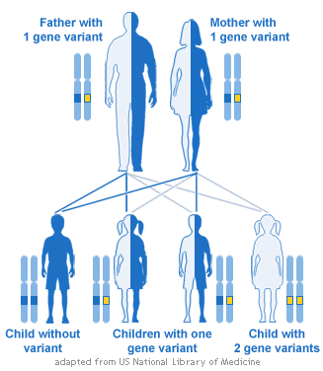
Two Gene Variant
Two gene variants

Slide 21
Heterozygous Defect
If both parents are heterozygous for the defect, then there is a:
25% chance child will be homozygous defective
25% chance homozygous normal
50% chance heterozygous defective

Slide 22
Homozygous Defect
If both parents are homozygous for a defect, then all children will be homozygous defective as well.
If both parents are homozygous normal, then all children will be normal as well.

Slide 23
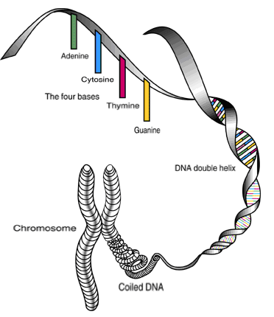
An Example of a SNP
At location for MTHFR position C677, which is rs1801133 (rung) of the DNA genome, or position 677 of the MTHFR-encoding portion of DNA, one normally find two cytosine (C) nucleotides.

Slide 24
Heterozygous SNP
If one of the cytosine (C) nucleotides has been replaced by a thymine (T), the SNP (“swap”) is referred to as an MTHFR C677T heterozygous SNP.
It is estimated that the MTHFR enzymatic activity may be reduced by 20-30% (less methylfolate).

Slide 25
Homozygous SNP
If both cytosine nucleotides have been replaced by thymine, the SNP is referred to as an MTHFR C677T homozygous SNP.
Consequently, the MTHFR enzymatic activity may be reduced by up to 60 to 80%.

Slide 26
What a SNP may do:
Results in the selection of an alternate amino acid, which may:
Change the shape of the resulting polypeptide.
Impact the function of the enzyme, receptor, or carrier protein.

Slide 27
So What Can Happen?
SNPs may cause down-regulation, or slower enzymatic activity, receptor function and carrier protein function.
But, a few SNPs may cause up-regulation, or faster enzymatic activity, receptor function and carrier protein function.

Slide 28
So What Does this Mean?
A person with a heterozygous or a homozygous SNP may have a decreased ability to convert (substrate A) to (product B).
Also, co-factors (vitamins, minerals, amino acids) are needed for this process as well, and lack of them can also create the same impact.
A
B

Slide 29
Summary
Thousands of reactions occur per second to make our mind and body work.
DNA is the instructions on how to make the enzymes that turn A into B.
SNPs in the DNA (inherited) or lack of cofactors can impede the reactions, resulting in dysfunction.
Finding the SNPs, results of the SNPs, can allow you to create a plan to compensate for the inherited deficiencies.

Slide 30
So what does this all mean???
Your DNA makes the enzymes that allows you to make energy from your food ( fats, carbs and proteins) Genetic variants may impact the energy production.
There are “waste products” (free radicals) as we make energy (ATP) that has to be “neutralized/cleared” from the body. Your DNA makes the enzymes that do the “clean up” ( anti-oxidants). Genetic variants may cause the “toxins” to build up and impact energy, immunity and detoxification.
There is a process called methylation, where the body uses a “methyl group” to turn off and on every process in the body. Genetic variants in the DNA can impact this process, causing dysfunction.
Finding the SNPs, results of the SNPs, can allow you to create a plan to compensate for the inherited deficiencies.

Slide 31
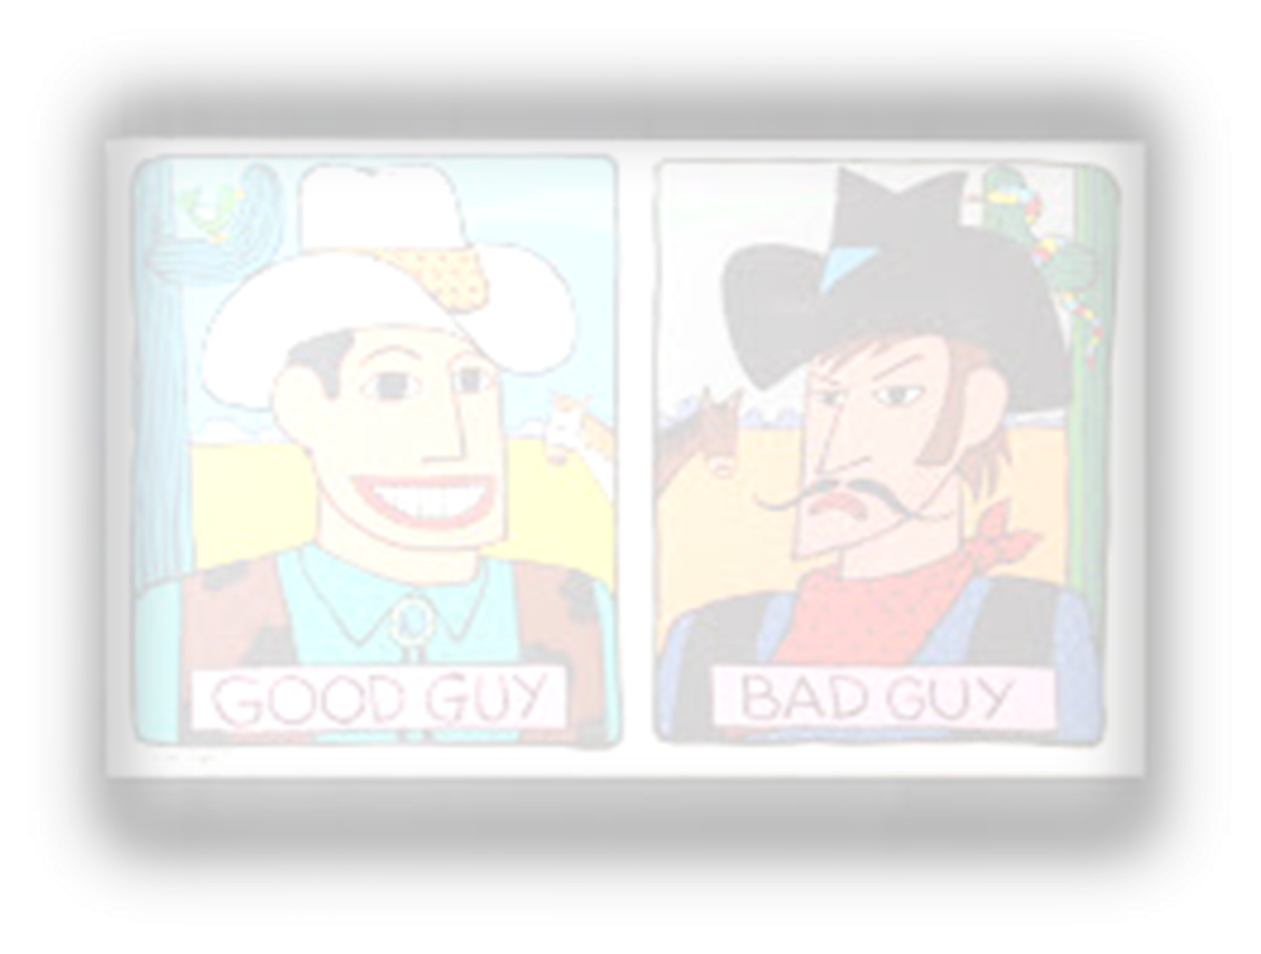
The “Good Guys” & the “Bad Guys”
The Good Guys (Boost)
The Bad Guys (Reduce)
Nutrient filled, food-based nutrition
Superoxide dismutase
Catalase
Glutathione
SAMe
NADH
Nitric oxide
BH4
Folate
Nrf2
Choline
Balanced neurotransmitters
Excess glutamate
Ammonia
Sulfites
Sulfates
Superoxide – free radical
Hydroxyl radicals
NOS uncoupling
Iron oxidation
Peroxynitrite
Homocysteine
Zonulin
Histamine

Slide 32
Example of Saliva Testing Data
rsid chromosome position genotype
rs2340592 1 910935 AG
rs13303118 1 918384 GT
rs78164078 1 921071 GG
rs6665000 1 924898 AA
rs2341362 1 927309 CC
rs9777703 1 928836 TT
rs139739199 1 935071 CC
rs142946364 1 937529 AG
rs3128117 1 944564 CT

Slide 34
Contact Information
Website for the genetic analysis software program and online certification course for health care practitioners: MethylGenetic Nutrition AnalysisTM www.dnasupplementation.com
MethylGenetic Nutrition AnalysisTM contact person: Yvonne Lucchese, HHP National Director of Sales 717-733-2003 yvonnel@dnasupplementation.com
Education Coordinator: Ellen Stark 717-733-2003 ellens@tolhealth.com
Website for the general public to learn about genetics and find a health care professional/referral page: Get to Know Your DNA www.gettoknowyourdna.com

Slide 35
Genetic Variants Found Higher in Chronic Lyme
Oslo, Norway
April 24,2017
Robert Miller, CTN
Certified Traditional Naturopath
Founder & President
NutriGenetic Research Institute

Slide 36
The Three Major Findings in Genetic Lyme Studies
Genetic variants that would impact ATP production (energy) in the cell.
Urea Cycle Weakness - the Urea Cycle clears ammonia, and variants may allow ammonia to stay higher.
Excess Glutamate causing anxiety, and inflammation.
Excess Iron Absorption causing hydroxyl radicals and inflammation.
Weakness in major cellular antioxidant/detox system, Nrf2 and Keap1.

Slide 37
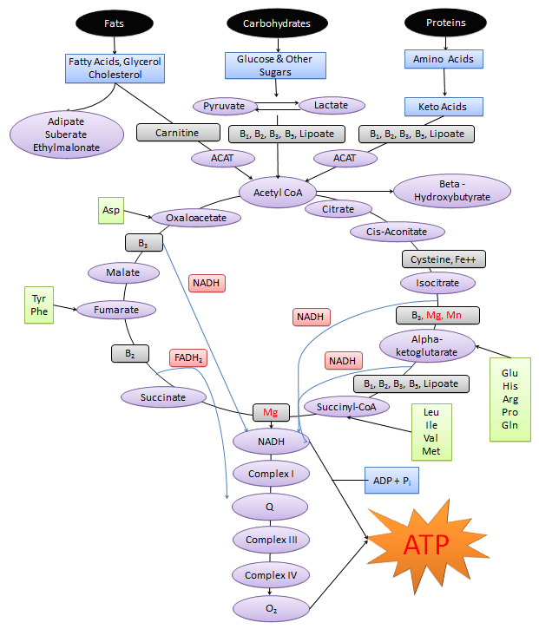
Krebs Cycle

Slide 39
The Krebs Cycle
The SCL genes support carnitine delivery into the cell
The ACAT genes support the conversion of fats and proteins into Acetyl-CoA, the first step of the Krebs Cycle
The NDUF genes, finish the job of making ATP
Those with Chronic Lyme were found to have higher amounts of variants in all three of these genes
If these genes are variated, L Carnitine, Pantethine and CoQ10 supplementation may be helpful

Slide 40
Glutamate
Glutamate is a neurotransmitter (and other things) that makes you intelligent and motivated. Glutamate is also inflammatory and may suppress the immune system.
GABA is relaxing, and helps you stay calm and sleep.
The GAD genes support the glutamate into GABA (relaxing).
ATP is needed to support the conversion of glutamate into GABA.
Those with Chronic Lyme were found to have higher amounts of variants in the GAD genes and lower ATP.
L-Theanine and Honokiol may be helpful.

Slide 41
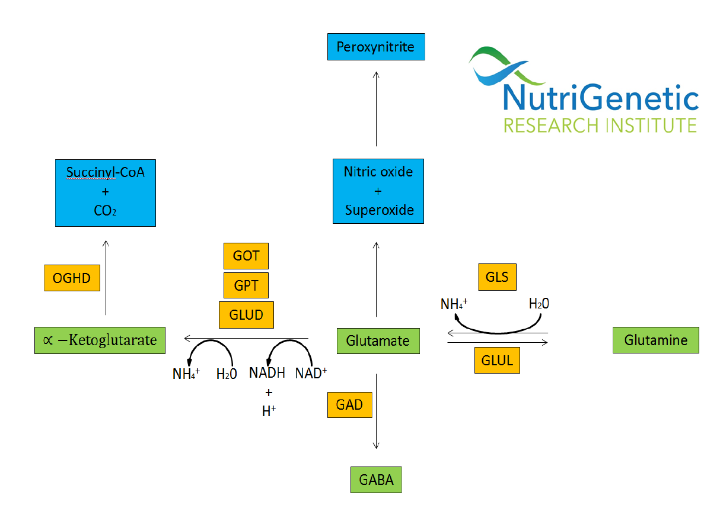
Glutamate

Slide 43
Ammonia
High levels of ammonia can create brain fog, and deplete BH4 which can cause inflammation and immune weakness.
The Urea Cycle clears ammonia.
Genetic variants in the Urea Cycle will cause ammonia to remain high.
Those with Chronic Lyme were found to have higher amounts of variants in the Urea Cycle.
Ornithine, Citrulline and Larch Bark may helpful.

Slide 44
Urea Cycle
CPS1
Carbamoyl Phosphate Synthetase I
OTC
Urea
Citrulline
Ornithine
ARG1
ASS1
Arginine
Argininosuccinic Acid
ASL

Slide 45
Iron
High levels of iron can create hydroxyl radicals which can cause inflammation and immune weakness.
The HFE genes, when variated, will cause more iron to be absorbed.
Higher levels of iron, will combine with cysteine and hydrogen peroxide to make dangerous hydroxyl radicals.
Those with Chronic Lyme were found to have higher amounts of variants in the HFE genes, as well as variants that increase cysteine.
Skullcap and Lactoferrin may be helpful, as well as lowering iron intake.

Slide 49
Contact Information
Website for the genetic analysis software program and online certification course for health care practitioners: MethylGenetic Nutrition AnalysisTM www.dnasupplementation.com
MethylGenetic Nutrition AnalysisTM contact person: Yvonne Lucchese, HHP National Director of Sales 717-733-2003 yvonnel@dnasupplementation.com
Education Coordinator: Ellen Stark 717-733-2003 ellens@tolhealth.com
Website for the general public to learn about genetics and find a health care professional/referral page: Get to Know Your DNA www.gettoknowyourdna.com

Slide 50
Iron & Hydroxyl Radicals
Oslo, Norway
April 24,2017
Robert Miller, CTN
Certified Traditional Naturopath
Founder & President
NutriGenetic Research Institute

Slide 51
Phase II
To explain Phase II study, simply, there were more variants that led to higher glutamate, more inflammation and weaker immune.
These additional variants will provide more methods for us to support excess glutamate.

Slide 52
Genetic Variants in the Neurotransmitter Genes
Dopa Decarboxylase
Serotonin
Glutaminase
SNPs may increase Glutamate
Dopamine
Ammonia
Glutamate
GAD
GABA
Tyrosine
5-HTP
CNR1
GAD SNPs will slow conversion and increase glutamate which creates Peroxynitrite
Ammonia depletes BH4
Serotonin supports immune
SNPs decrease BH4, Serotonin & Dopamine & increase O₂⁻
BH4
Immune Function
Glutamate creates Peroxynitrite
ATP
Alpha-ketoglutarate
GCH1
Peroxynitrite suppresses BH4
GOT1 will slow Oxaloacetate and lower production of ATP
GOT1
GCH1 deficiency will lead to higher O₂⁻
BH2
Peroxynitrite inhibits immune
Peroxynitrite reduces ATP
Arginine
GRIA 1 & 2
Neurotransmitter receptors in human brains
Oxaloacetate
Super Oxide Free Radical O₂⁻
Nitric Oxide
Peroxynitrite
Depletes glutathione, creates hydroxyl radicals, increases inflammation, lowers immune function
DOPA
Krebs Cycle
SOD - 02
DDC
DDC is involved in the complex neuroendocrine-immune regulatory network
Superoxide Dismutase
GSH
Glutathione
Dopamine
H₂O & O₂
DRD 2 & 3
Dopamine Receptor
GSH
Catalase
DBH
H₂O₂
Glutathione activates
co-factor regeneration
Activated T Cell
•OH
^{Hydroxyl Radicals}
H₂
H₂O
Hydrogen selectively neutralizes hydroxyl
radicals generated by the Fenton Reaction
Norepinephrine supports immune function
Norepinephrine
Fe2⁺
Fe³⁺
IL-2/IL4 and IFNy inhibition
Immune Function
Activation & differentiation of naïve T-cells

Slide 53
Phase III
In Phase III, we expanded our look into Fenton Reaction and hydroxyl radicals.
In addition to HFE genes, the SLC40A1 genes cause iron to stay stuck in the cell.
There is a process in every cell called Keap1 and Nrf2 that fights the inflammation.
In those with chronic Lyme, we found a higher percentage of Keap1 and Nrf2 variants.

Slide 54
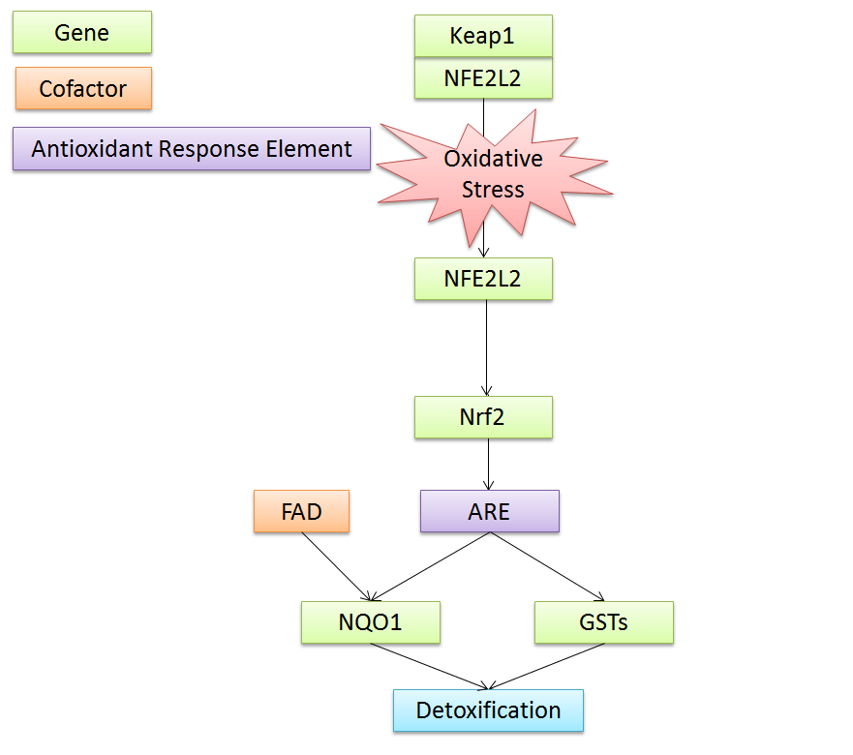
Nrf2

Slide 55
Nrf2

Slide 56
Nrf2 and Keap1 Variants
We are seeing that the “sickest of the sick” have Keap1 and Nrf2 variants.
When combined with the Fenton reaction and SLC40A1 variants, it makes the perfect storm.
Sulforaphane from broccoli seed supports Nrf2, as well as Milk Thistle, Bacopa and a few other herbs.
Supporting Nrf2 and Keap1 in those with variants may provide excellent nutritional help.

Slide 57
Hydrogen & Hydroxyl Radicals
Simple hydrogen H2, will turn hydroxyl radicals into H20.
Adding hydrogen to the body through ingestion on inhalation may be helpful to neutralize the radicals.
www.hightechhealth.com has a breathable hydrogen unit.
Coming soon, hydrogen tablet from PHP.

Slide 60
Phase IV - Philadelphia
We will be adding more genes that impact Nrf2, hydrogen peroxide clearing and Fenton Reaction related genes, including copper.

Slide 61
Case Study and Q&A
If time permits we will do a case study and then Q&A

Slide 62
Contact Information
Website for the genetic analysis software program and online certification course for health care practitioners: MethylGenetic Nutrition AnalysisTM www.dnasupplementation.com
MethylGenetic Nutrition AnalysisTM contact person: Yvonne Lucchese, HHP National Director of Sales 717-733-2003 yvonnel@dnasupplementation.com
Education Coordinator: Ellen Stark 717-733-2003 ellens@tolhealth.com
Website for the general public to learn about genetics and find a health care professional/referral page: Get to Know Your DNA www.gettoknowyourdna.com

